Slide 1


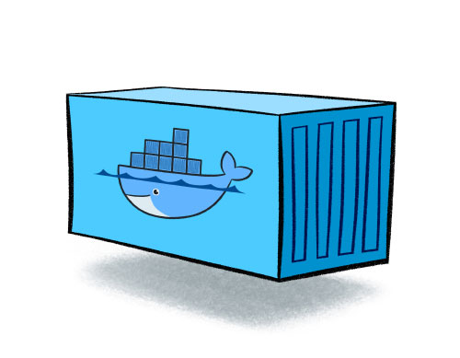
SHIPPING CHALLENGE
MILESTONE 2

Slide 2
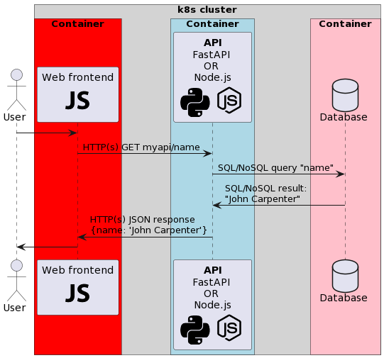
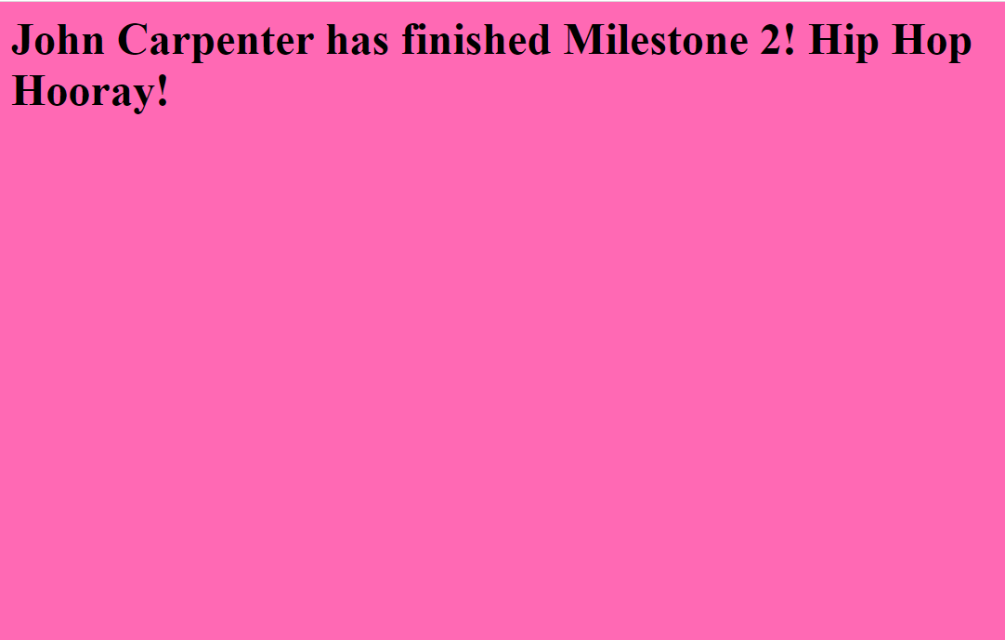
The application
Set up a web application stack consisting of 3 containers
A web frontend, serving a javascript web page
A FastAPI or Node.js service with
          API endpoint that gets name
          API endpoint that gets container ID
A backend database that stores the name
Result:
Notes:
@startuml
!include <cloudinsight/python>
!include <tupadr3/common>
!include <tupadr3/devicons/javascript>
!include <tupadr3/devicons/nodejs_small>
actor User
!pragma teoz true
box "k8s cluster" #LightGrey
box "Container" #Red
participant "Web frontend\n<$javascript>" as webapp
end box
box "Container" #LightBlue
participant "**API**\nFastAPI \nOR \nNode.js\n<$python><$nodejs_small>" as API
end box
box "Container" #Pink
database "Database" as db
end box
end box
User -> webapp
webapp -> API : HTTP(s) GET myapi/name
API -> db : SQL/NoSQL query "name"
db -> API : SQL/NoSQL result:\n"John Carpenter"
API -> webapp : HTTP(s) JSON response \n{name: 'John Carpenter'}
User <- webapp
@enduml

Slide 3
The challenge
Create your own kubernetes cluster with at least 1 worker
Containerized application on worker is the following
  When the name changes in Db, webpage changes automatically
  When layout of webpage changes, the worker will display the new layout (automatically, or after an image rebuild)
  You use the webstack which is assigned to you in this document
Notes:
@startuml
!include <cloudinsight/python>
!include <tupadr3/common>
!include <tupadr3/devicons/javascript>
!include <tupadr3/devicons/nodejs_small>
actor User
!pragma teoz true
box "k8s cluster" #LightGrey
box "Container" #Red
participant "Web frontend\n<$javascript>" as webapp
end box
box "Container" #LightBlue
participant "**API**\nFastAPI \nOR \nNode.js\n<$python><$nodejs_small>" as API
end box
box "Container" #Pink
database "Database" as db
end box
end box
User -> webapp
webapp -> API : HTTP(s) GET myapi/name
API -> db : SQL/NoSQL query "name"
db -> API : SQL/NoSQL result:\n"John Carpenter"
API -> webapp : HTTP(s) JSON response \n{name: 'John Carpenter'}
User <- webapp
@enduml

Slide 4
How to earn points?
0/20 - be like Homer Simpson or Al Bundy
5/20 - stack in Docker
10/20 - kind or microk8s or minikube cluster with 1 worker that runs your stack
Extra POINTS:
Enable HTTPS on k8s using a valid, public certificate (use cert-manager) -> +2 points
Extra worker in your k8s cluster + scaling of API across nodes using ingress (show container id on frontend) -> +1 points
Health check monitoring your API that restarts automatically when unhealthy -> +1 points
Monitor your cluster resources and performance using Prometheus -> +2 points
Finally, to earn the last 4 points and become the k8s champion:
  Set up a Kubeadm cluster with 2 workers and 1 controller node, running and load balancing your stack.
OR
  Use a Helm Chart to set up ArgoCD on your k8s cluster and implement a GitOps workflow to deploy your app automatically.

Slide 5
Delivery: The Document
First, you will deliver a document (similar to milestone 1) to explain your solution. The deadline for this milestone is 11/01/2026. This document is for proof and reference purposes. The evaluation is based on the demo during the teams call!
The rules, again:
Don’t change or add anything after the deadline. You will show us what you have documented during the evaluation!
Don’t copy each others document, we will use Turnitin to check for plagiarism
Use your initials for image, container names etc..
Your document has a nice, professional layout and a proper introduction and conclusion
Document every step and command you enter to accomplish this. Use readable screenshots. Explain every parameter and option inside the commands as well. What does it do and why are you using it?
Show your configuration files and explain all important lines.

Slide 6
Delivery: The Demo
You can only earn the points after showing a working demo and answering questions about all the configured items.
We will call you via MS Teams on 16/01/2026 or 21/01/2026, registration links will follow.
The call takes 15-20 minutes. You show us your solution and get questions about your stack.
You answer them in a smooth way while showing the part covering the question.
In this way you will show that you understand the solution you made and how it is constructed.

Slide 7
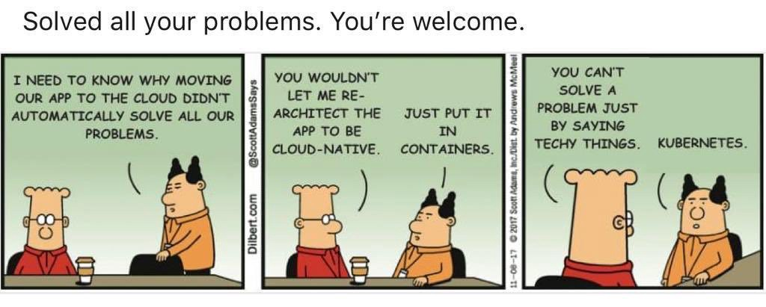
Now go, have fun and learn a lot!

